Slide 1

The main industrial event of the year in Lithuania

Slide 2

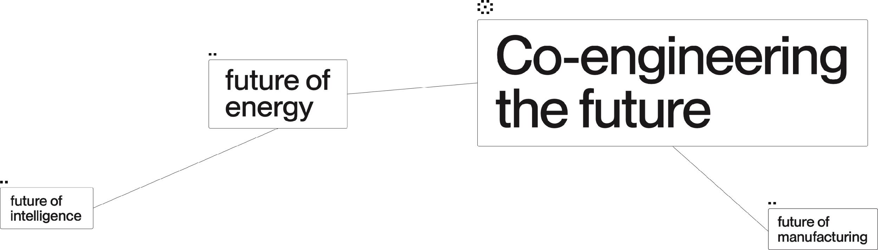

2026 June 3-4

Slide 3


enginuum 2026
Exhibition
participants
Broad Industry
Nucleus
Ecosystem

Slide 4

enginuum 2026
Exhibition participants
Nucleus
Broad industrial sector
Ecosystem
Processing manufacturing and engineering
Industrial IT and artificial intelligence
Science, universities, colleges, vocational training
Engineering services and design (professional, scientific, technical activities)
Energy
Innovation and export ecosystem
Defence and security industry (dual-use technologies)
Construction and industrial infrastructure
Finance and insurance for industry
High-tech
Transport, logistics and supply chains.
Associations and umbrella organisations

Slide 5
enginuum 2026
Exhibition structure
Exposition part
Innovation Island
Conferences and stages
Business meetings
Youth and talent programme
Aim: to showcase a dynamic industry - equipment, technology, solutions
A place to showcase prototypes, R&D projects, start-ups, university innovations
Aim: to bring together policies, strategies and practical examples
“Where contracts are born”. Aim: to lay a foundation for transactions and partnerships
Aim: to help the industry cultivate and develop new talent

Slide 6


enginuum 2026
Conference stages
Industry Summit
Tech & Innovation
Business & Export
Talents & Education
Ministers, other associations, international guests.
Topics: industrial competitiveness, defence industry, energy policy, talent.
Very specific presentations: robotics, digitisation, AI, lasers, circular economy.
Opening of markets.
Supply chains, partnerships, clusters, financing.
Discussions on the attractiveness of engineering professions, dual training, scholarships.
Presentations of student and pupil programme, hackathon results.

Slide 7

enginuum 2026
Business meetings during “Enginuum”:
Hosted Buyer programme
B2B matchmaking
manufacturers
suppliers
LT companies
foreign delegations
defence purchasers
manufacturers
Start-ups - industry pitch sessions, synergies with other events

Slide 8
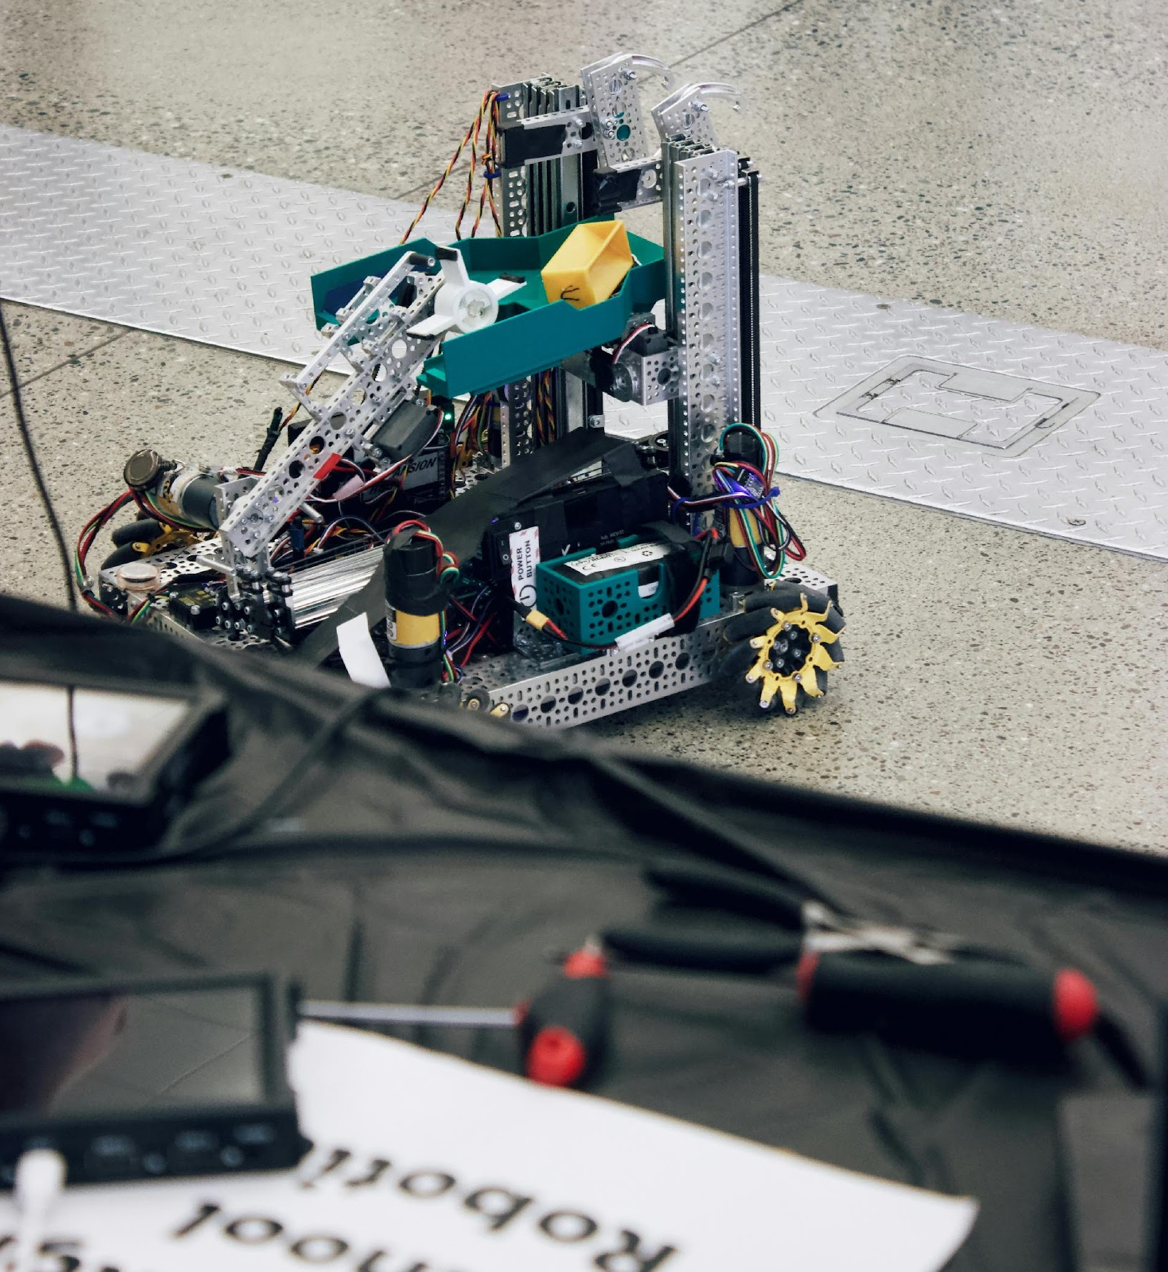
enginuum 2026
Young Engineer’s Day. A special day for pupils and students.
Tours around the stands with clearly defined educational stations (robotics, lasers, AI).
Competitions: prototype contests, robot battles, mini-hackathon.

Slide 9
enginuum 2026
Expectation for 2026
90
3
4
Exhibition participants
Exhibition halls
Stages
10
150
3000
Hosted Buyer
programme participants
B2B meetings
Exhibition visitors

Slide 10

enginuum 2026
Future
of intelligence
Co-engineering
the future
Future
of making
Future
of security
Future of
manufacturing
Future
of energy

Slide 11


Slide 12



Let’s create the event together
2026 June 3-4

Slide 13
Edita Grušienė
e.grusiene@litexpo.lt
+370 658 32 093

